Slide 1
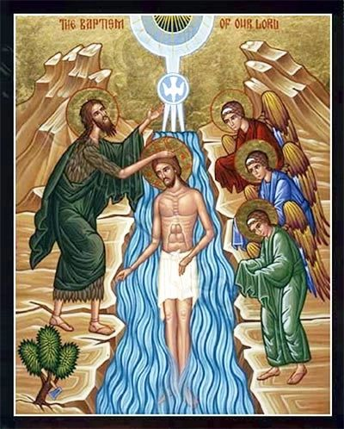
THE BAPTISM OF THE LORD

Slide 2
Opening Hymn
1 Songs of thankfulness and praise,
Jesus, Lord to thee we raise,
manifested by the star
to the sages from afar;
branch of royal David's stem
in thy birth at Bethlehem;
anthems be to thee addressed;
God in man made manifest.

Slide 3
Opening Hymn
2 Manifest at Jordan's stream,
prophet, Priest and King supreme,
and at Cana wedding-guest
in thy Godhead manifest,
manifest in power divine,
changing water into wine;
anthems be to thee addressed;
God in man made manifest.

Slide 4
Opening Hymn
3 Grant us grace to see thee, Lord,
mirrored in thy holy word;
may we imitate thee now
and be pure, as pure art thou;
that we like to thee may be
at thy great Epiphany,
and may praise thee, ever blest,
God in man made manifest.

Slide 5
Introduction and Greeting
Priest: In the name of the Father, and of the Son, and of the Holy Spirit.
All: Amen.
Priest: The Lord be with you.
All: And with your spirit.
The priest welcomes all present, and briefly introduces the Mass

Slide 6
Blessing and Sprinkling of Holy Water
1 Baptised in water, sealed by the Spirit,
cleansed by the blood of Christ our King:
trusting his promise, heirs of salvation,
faithfully now God's praises we sing.
2 Baptised in water, sealed by the Spirit,
dead in the tomb with Christ our King:
one with his rising, freed and forgiven,
thankfully now God's praises we sing.
3 Baptised in water, sealed by the Spirit,
marked with the sign of Christ our King:
born of one Father, we are his children,
joyfully now God's praises we sing.

Slide 7
Gloria
Glory to God in the highest, and on earth peace to people of good will. We praise you, we bless you, we adore you, we glorify you, we give you thanks for your great glory, Lord God, heavenly King, O God, almighty Father.
Lord Jesus Christ, Only Begotten Son, Lord God, Lamb of God, Son of the Father, you take away the sins of the world, have mercy on us; you take away the sins of the world, receive our prayer; you are seated at the right hand of the Father have mercy on us.
For you alone are the Holy One, you alone are the Lord, you alone are the Most High, Jesus Christ, with the Holy Spirit, in the glory of God the Father. Amen.

Slide 8
Opening Prayer (Collect)
Priest: Let us pray.
All take a moment of silence to think of the prayers we are bringing to Mass today.
Then the Priest says the Collect, at the end of which the people acclaim:
All: Amen.
All sit for the Liturgy of the Word

Slide 9
First Reading
A reading from the prophet Isaiah
42:1-4, 6-7: ‘Behold my servant, in whom my soul delights.’
To indicate the end of the reading, the reader acclaims:
R: The word of the Lord.
All: Thanks be to God.

Slide 10
Responsorial Psalm
Ascribe to the Lord, you heavenly powers,
ascribe to the Lord glory and strength.
Ascribe to the Lord the glory of his name;
bow down before the Lord, majestic in holiness.
The voice of the Lord upon the waters,
the Lord on the immensity of waters;
the voice of the Lord full of power;
the voice of the Lord full of splendour.
The God of glory thunders;
in his temple they all cry, ‘Glory!’
The Lord sits enthroned above the flood;
the Lord sits as king for ever.

Slide 11
Second Reading
A reading from the Acts of the Apostles
10:34-38: ‘God anointed Jesus with the Holy Spirit.’
To indicate the end of the reading, the reader acclaims:
The word of the Lord.
All: Thanks be to God.

Slide 12
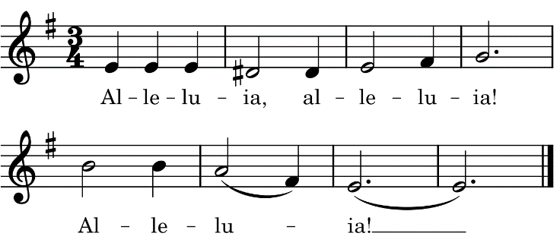
Gospel Acclamation
The heavens were opened and the voice of the Father thundered: ‘This is my beloved Son; listen to him’.
Repeat “Alleluia!”

Slide 13
Gospel
Priest: The Lord be with you.
All: And with your spirit.
Priest: A reading from the holy Gospel according to Matthew
A: Glory to you, O Lord.
3:13-17: ‘When Jesus was baptised he saw the Spirit of God coming to rest on him.’
At the end of the Gospel, the Priest acclaims:
Priest: The Gospel of the Lord.
All: Praise to you, Lord Jesus Christ.
Repeat “Alleluia!” as the Gospel Book is enthroned

Slide 14
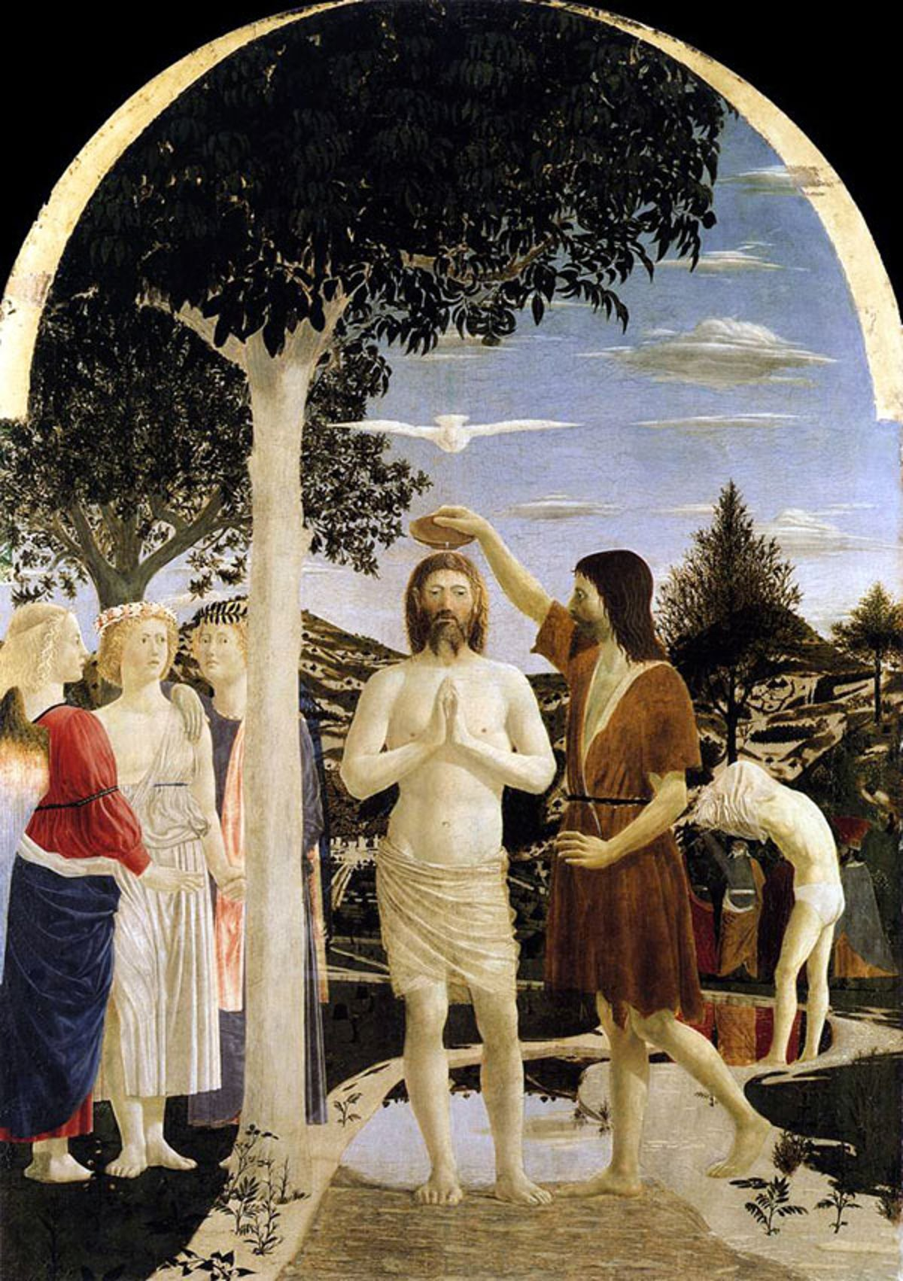

Slide 15
The Profession of Faith
I believe in one God, the Father almighty, maker of heaven and earth, of all things visible and invisible.
I believe in one Lord Jesus Christ, the Only Begotten Son of God, born of the Father before all ages. God from God, Light from Light, true God from true God, begotten, not made, consubstantial with the Father; through him all things were made. For us men and for our salvation he came down from heaven:
All bow during these lines:
AND BY THE HOLY SPIRIT WAS INCARNATE OF THE VIRGIN MARY, AND BECAME MAN.

Slide 16
The Profession of Faith
For our sake he was crucified under Pontius Pilate, he suffered death and was buried, and rose again on the third day in accordance with the Scriptures. He ascended into heaven and is seated at the right hand of the Father. He will come again in glory to judge the living and the dead and his kingdom will have no end.

Slide 17
The Profession of Faith
I believe in the Holy Spirit, the Lord, the giver of life, who proceeds from the Father and the Son, who with the Father and the Son is adored and glorified, who has spoken through the prophets.
I believe in one, holy, catholic and apostolic Church. I confess one Baptism for the forgiveness of sins and I look forward to the resurrection of the dead and the life of the world to come. Amen.

Slide 18
Prayer of the Faithful
Reader: Lord, in your mercy.
All: Hear our prayer.
All: Hail Mary, full of grace,
the Lord is with thee.
Blessed art thou among women,
and blessed is the fruit of
thy womb, Jesus. Holy Mary,
Mother of God, pray for us
sinners now, and at the hour
of our death. Amen.
The priest says a Concluding
Prayer, to which all reply:
All: Amen

Slide 19
Hymn at the Presentation of the Gifts
  1 When Jesus comes to be baptised,
  He leaves the hidden years behind,
  The years of safety and of peace,
  To bear the sins of all mankind.
  2 The Spirit of the Lord comes down
  anoints the Christ to suffering,
  to preach the word, to free the bound,
  and to the mourner, comfort bring.
  3 He will not quench the dying flame
  and what is bruised he will not break,
  but heal the wound injustice dealt
  and out of death his triumph make.

Slide 20
Presentation of the Gifts
The Priest completes the preparation of the gifts at the altar, and the people rise as he says:
Priest: Pray, brothers and sisters, that my sacrifice and yours may be acceptable to God, the almighty Father.
All: May the Lord accept the sacrifice at your hands for the praise and glory of his name, for our good and the good of all his holy Church.
Then the Priest says the Prayer over the Offerings, at the end of which the people acclaim:
All: Amen.

Slide 21
The Eucharistic Prayer
Priest: The Lord be with you.
All: And with your spirit.
Priest: Lift up your hearts.
All: We lift them up to the Lord.
Priest: Let us give thanks to the Lord our God.
All: It is right and just.
The priest then says or sings the Preface, which always ends with the invitation to join the host of heaven in singing the praises of God:

Slide 22
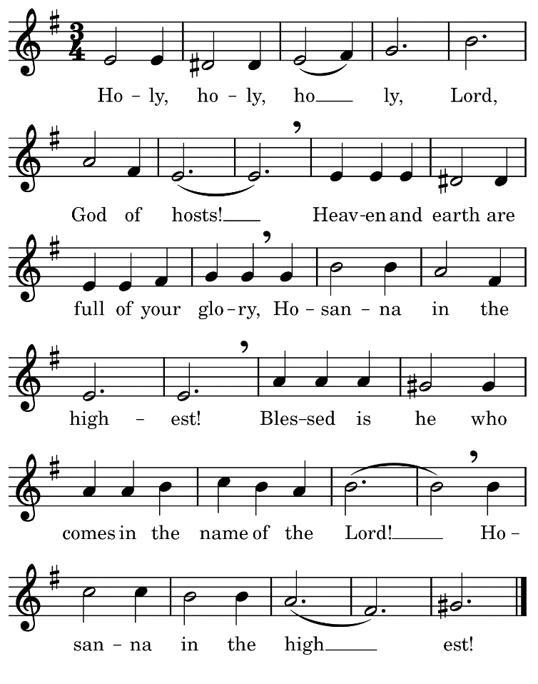

Slide 23
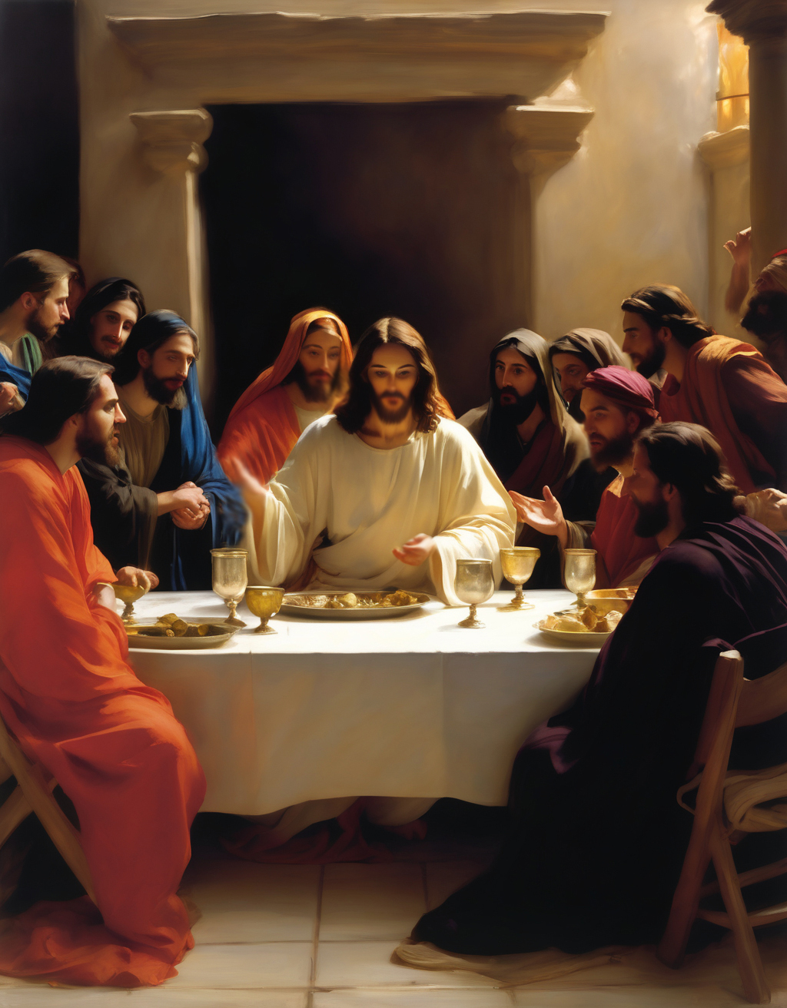

Slide 24
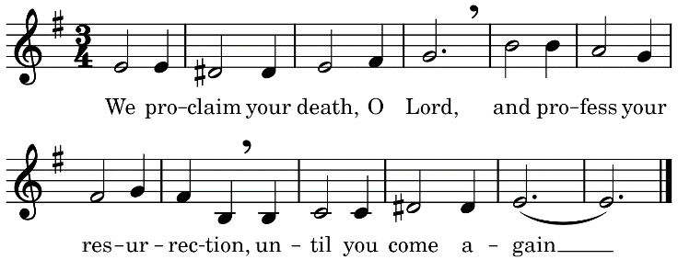
The Eucharistic Prayer
After the words of Consecration
the priest sings:
Priest: The mystery of faith.
All: We proclaim your death, O Lord, and profess your Resurrection, until you come again.

Slide 26
The Eucharistic Prayer
At the conclusion of the prayer the Priest takes the chalice and the paten with the host and, raising both, he sings:
Through him, and with him, and in him, O God, almighty Father, in the unity of the Holy Spirit, all glory and honour is yours, for ever and ever.
All: Amen.

Slide 27
The Communion Rite
Priest: At the Saviour’s command and formed by divine teaching, we dare to say:
All: Our Father, who art in heaven, hallowed be thy name; thy kingdom come, thy will be done on earth as it is in heaven. Give us this day our daily bread, and forgive us our trespasses, as we forgive those who trespass against us; and lead us not into temptation, but deliver us from evil.
The priest prays, then all conclude the prayer:
All: For the kingdom, the power and the glory are yours now and for ever.

Slide 28
The Communion Rite
Priest: The peace of the Lord be with you always.
All: And with your spirit.
Priest: Let us offer each other the sign of peace.
All offer one another the customary sign of peace.

Slide 29
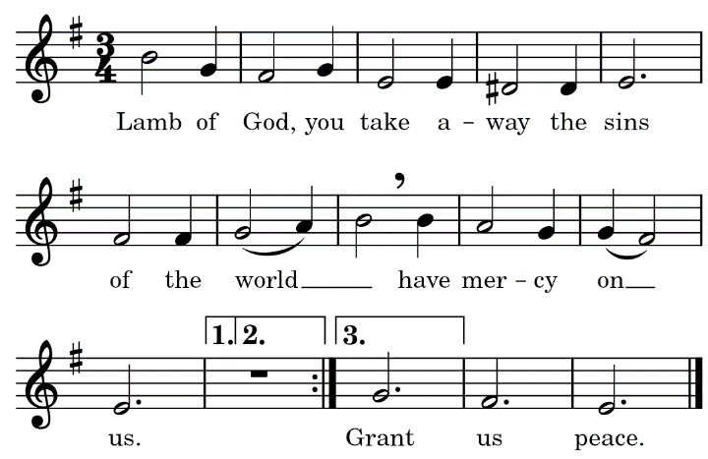
The Communion Rite
Lamb of God you take away the sins of the world; have mercy on us.
Lamb of God you take away the sins of the world; have mercy on us.
Lamb of God you take away the sins of the world; grant us peace.

Slide 30
The Communion Rite
After private prayers of preparation the Priest genuflects, takes the host and, holding it slightly raised above the chalice, says aloud:
P: Behold the Lamb of God, behold him who takes away the sins of the world. Blessed are those called to the supper of the Lamb.
A: Lord, I am not worthy that you should enter under my roof, but only say the word and my soul shall be healed.

Slide 31
The Communion Rite
As those in communion with the Catholic Church come forward to receive Holy Communion, anyone who is not receiving communion is invited to come forward with arms crossed over your chest to ask for a blessing if you wish.
Please allow those in the “side benches” to come forward first, up the side aisles. Then when the priest and ministers move to the centre aisle, everyone else comes forward up the centre aisle.
Communion Antiphon
A: Behold the One of whom John said: I have seen and testified that this is the Son of God.

Slide 32
Communion Hymn
1 I, the Lord of sea and sky,
I have heard my people cry.
All who dwell in dark and sin
my hand will save.
I who made the stars of night,
I will make their darkness bright.
Who will bear my light to them?
Whom shall I send?
Here I am, Lord. Is it I, Lord?
I have heard you calling in the night.
I will go, Lord, if you lead me.
I will hold your people in my heart.

Slide 33
Communion Hymn
2 I, the Lord of snow and rain,
I have borne my people's pain.
I have wept for love of them.
They turn away.
I will break their hearts of stone,
Give them hearts for love alone.
I will speak my word to them.
Whom shall I send?
Here I am, Lord. Is it I, Lord?
I have heard you calling in the night.
I will go, Lord, if you lead me.
I will hold your people in my heart.

Slide 34
Communion Hymn
3 I, the Lord of wind and flame,
I will tend the poor and lame.
I will set a feast for them.
My hand will save.
Finest bread I will provide
Till their hearts be satisfied.
I will give my life to them.
Whom shall I send?
Here I am, Lord. Is it I, Lord?
I have heard you calling in the night.
I will go, Lord, if you lead me.
I will hold your people in my heart.

Slide 35
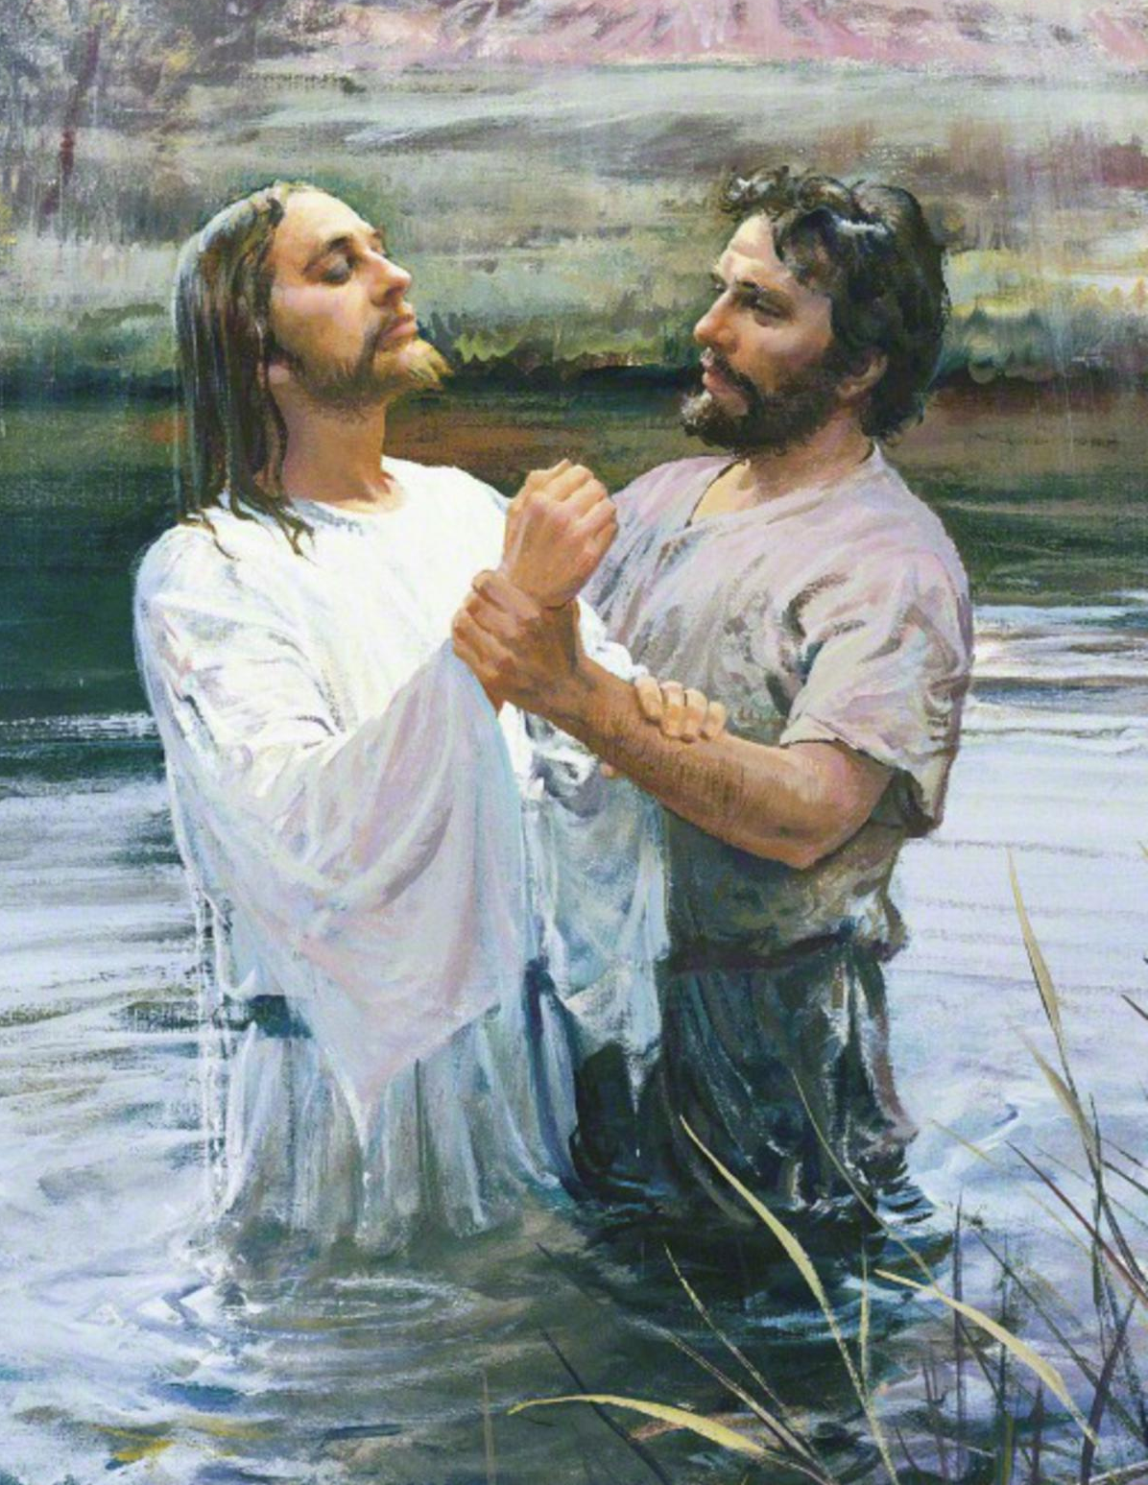

Slide 36
The Communion Rite
After the distribution of
Communion a sacred silence is observed for a while.
Priest: Let us pray.
The Priest says the Prayer after Communion, at the end of which the people acclaim:
All: Amen.

Slide 37
Concluding Rite
Priest: The Lord be with you.
All: And with your spirit.
Priest: May almighty God bless you, the Father, and the Son, and the Holy Spirit.
All: Amen.
Priest: Go forth, the Mass is ended.
All: Thanks be to God.

Slide 38
Final Hymn
1 Once in royal David's city
stood a lowly cattle shed,
where a mother laid her baby
in a manger for his bed;
Mary was that Mother mild,
Jesus Christ her little child.
2 He came down to earth from heaven,
who is God and Lord of all,
and his shelter was a stable
and his cradle was a stall;
with the poor, and mean, and lowly,
lived on earth our Saviour holy.

Slide 39
Final Hymn
4 Not in that poor lowly stable
with the oxen standing by,
we shall see him; but in heaven,
set at God's right hand on high;
when like stars his children crowned
all in white shall wait around.
The End of the Christmas Season

Slide 40


